Slide 1

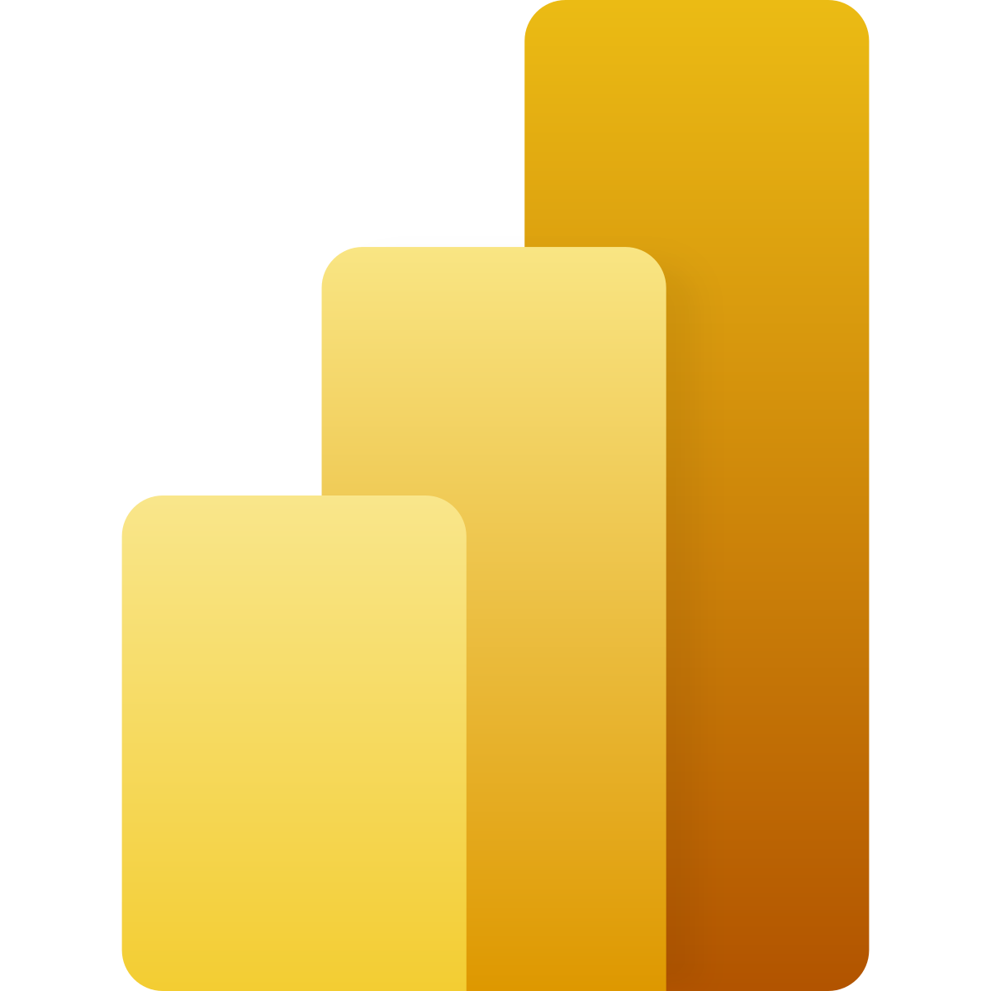
HOTEL BOOKING DATA ANALYSIS WITH POWER BI
Hilal GÜLERYÜZ

Slide 2
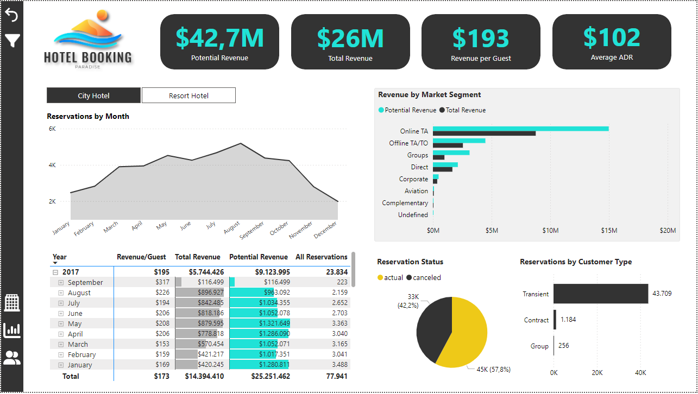

Slide 3
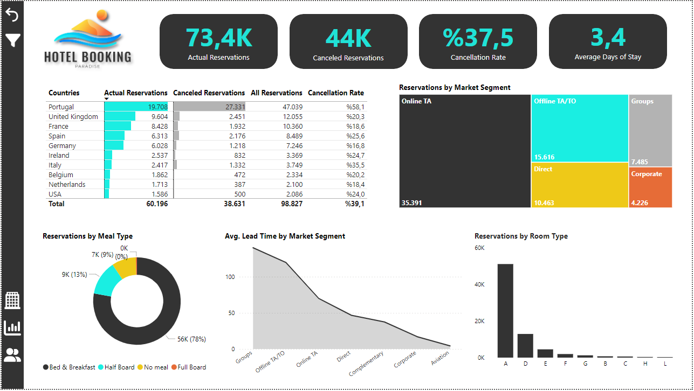

Slide 4
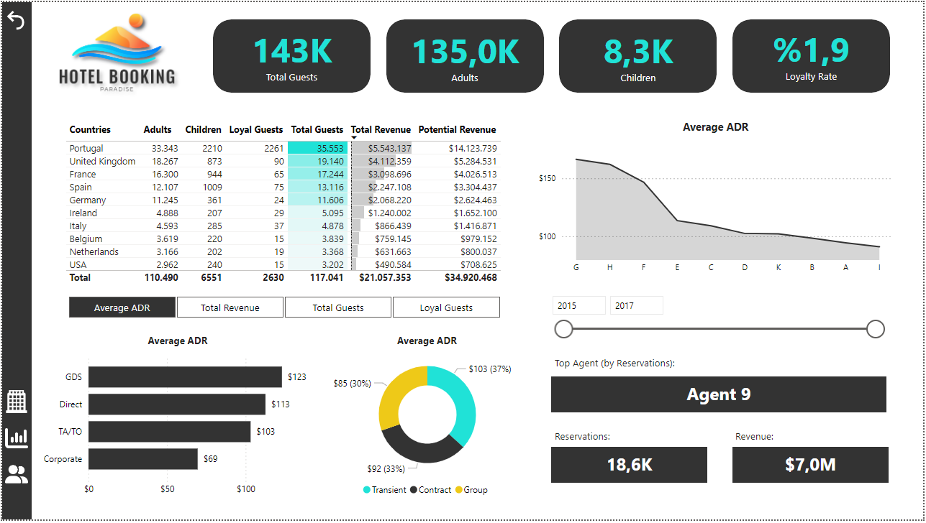

Slide 5
